Slide 1
Chapter 4-2
Processor Design
Pipelining CPU
Notes:
重点

Slide 2
Why pipelining : conclusion
Does Not improve latency for individual instruction不会改善单个指令的延迟
Improving of Throughput ( rather than individual execution time)提高吞吐量（而不是单独的执行时间）
Improving of efficiency for resources (functional unit) 提高资源效率（功能单元）

Slide 3
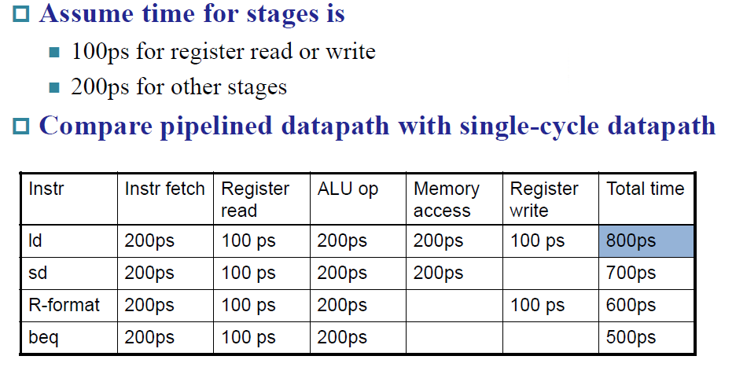
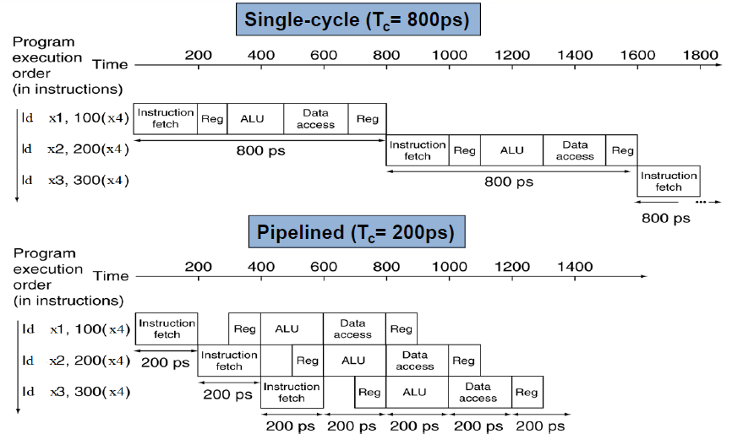
900
Ideal speedup is 阶段数
但不是阶段越多越好，阶段多会引入额外开销（延迟和硬件开销）
Notes:
单周期是整个流程比如800ps，流水线的cycle是一个stage比如200ps

Slide 4
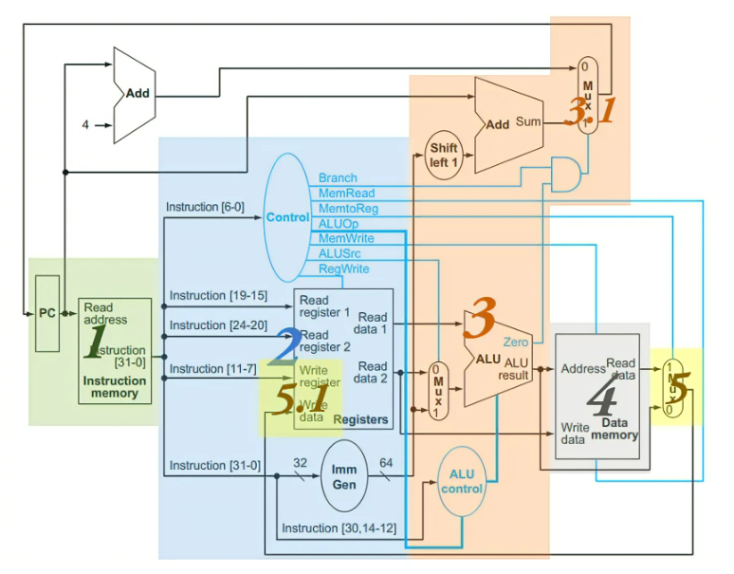
IF, Inst Fetch，从内存中获取指令
ID, Inst Decode，读取寄存器、指令译码
EX, Execute，计算操作结果和/或地址
MEM, Memory，内存存取（如果需要的话）
WB, Write Back，将结果写回寄存器（如果需要的话
RISC-V 也有很多流水线友好的设计，例如：
1. 所有 RISC-V 的指令长度相同，方便 IF 和 ID 的工作
2. RISC-V 的指令格式比较少，而且源寄存器、目标寄存器的位置相同
3. 只在 load 或 store 指令中操作 data memory 而不会将存取的结果做进一步运算，这样就可以将 MEM 放在比较后面的位置；如果还能对结果做运算则还需要一个额外的阶段，流水线较长是不好的

Slide 5
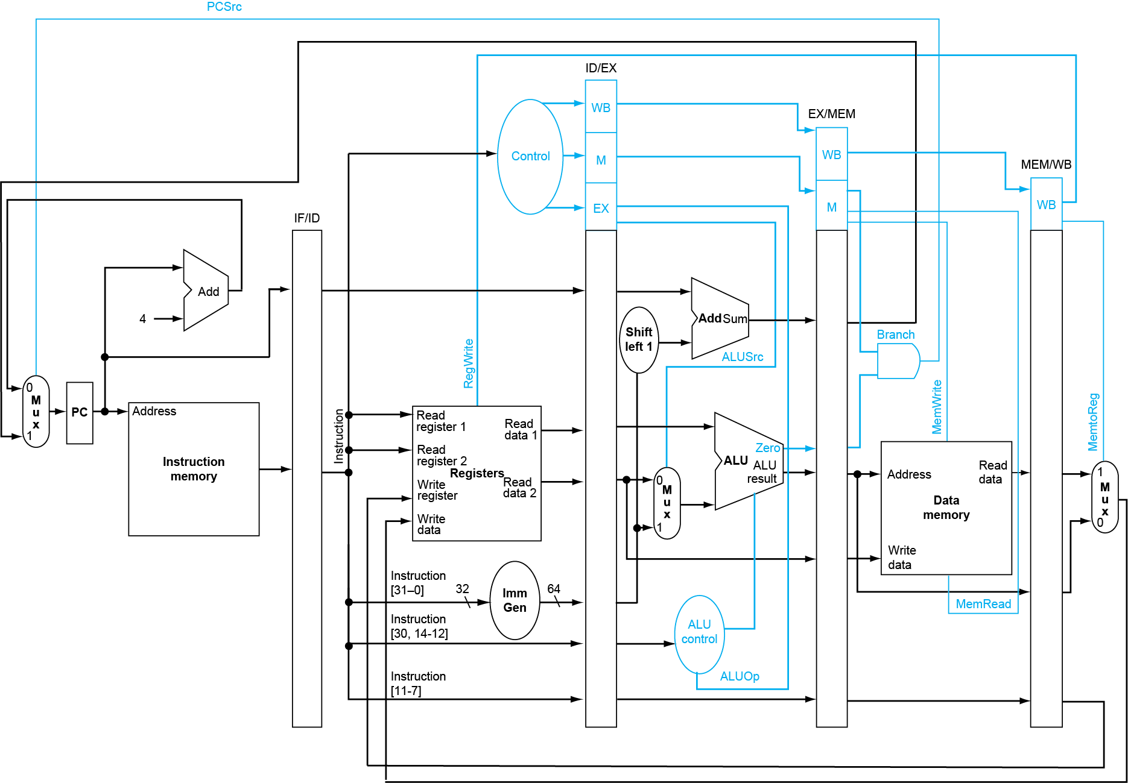
完整流水线数据通路
相比于单周期CPU，只是在各个阶段之间加入了流水线寄存器来存储值

Slide 6
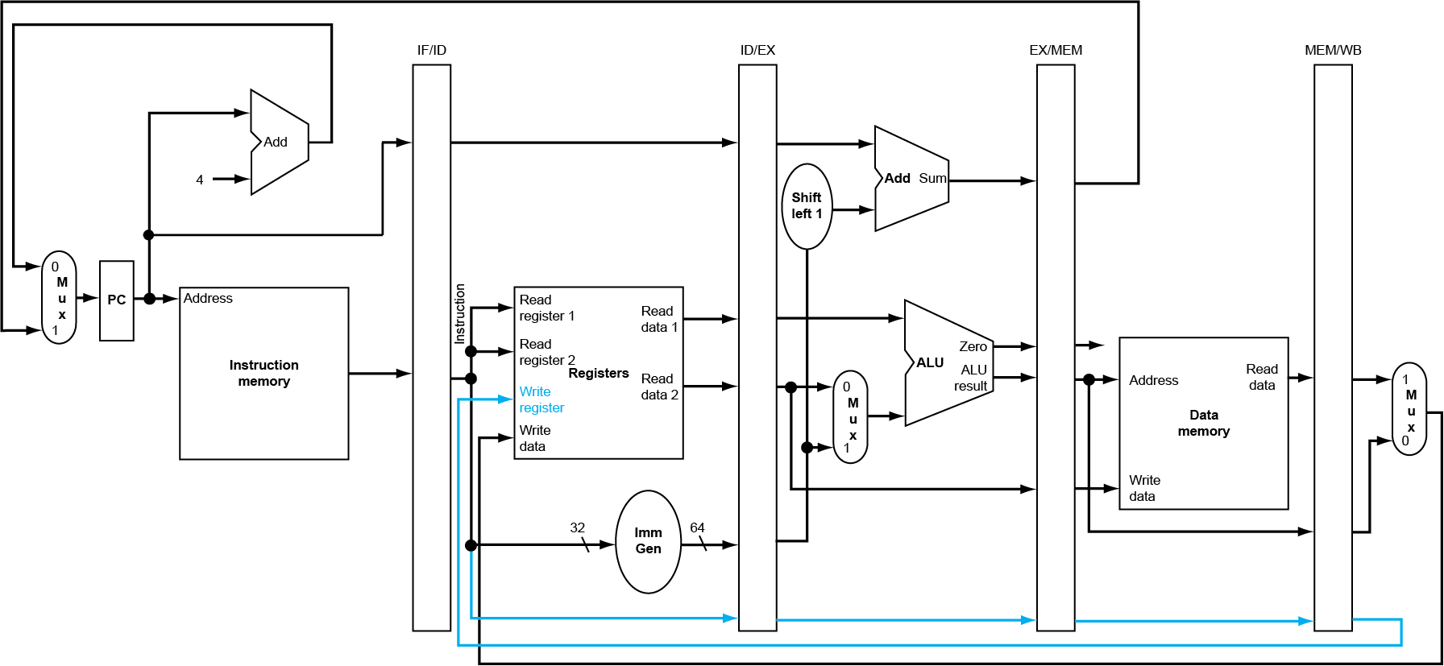
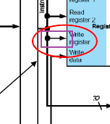
注意写回1：WB 阶段写回数据
如果地址不传递。则地址不见了，原来单周期是从PC里面来的，现在PC已经刷新过了（rd只会第五步用）
原先

Slide 7
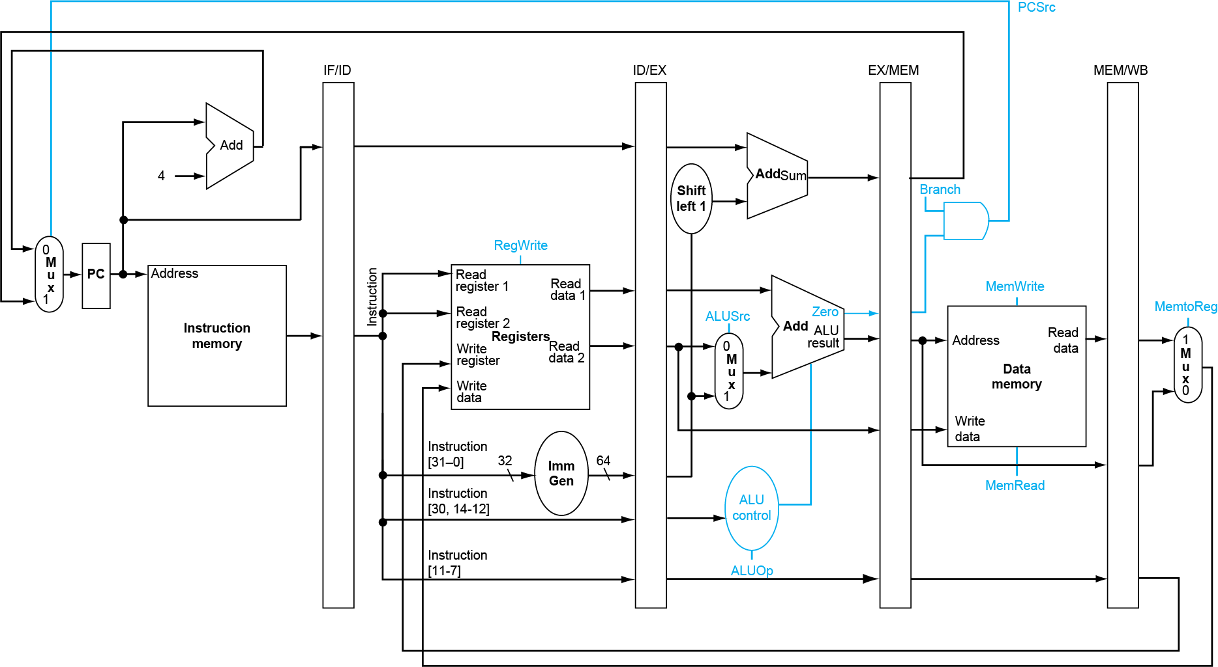
注意写回2：MEM 阶段判断是否发生跳转
产生控制信号

Slide 8
Right-to-left flow leads to hazards

Slide 9
performance issues in pipelining
Latency: 流水线中每条指令的执行时间并没有减少，反而总是比非流水线机器长
Imbalance 阶段之间会降低性能
Overhead 寄存器延迟和时钟偏移引起的上升也有助于机器周期的下限
Pipeline hazards 是管道的主要障碍，阻碍机器达到理想性能
Time to “fill” pipeline and time to “drain” it reduces speedup

Slide 10
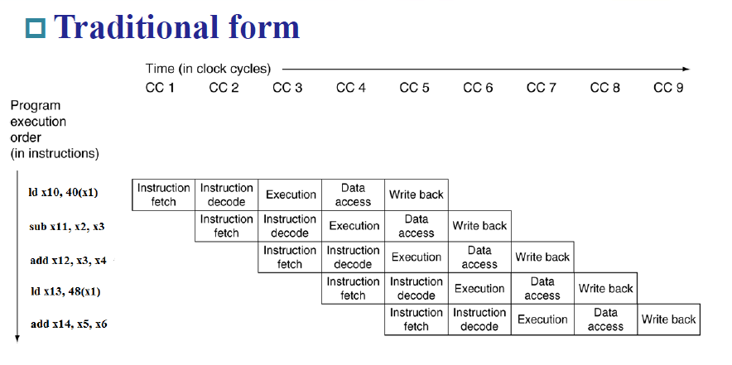
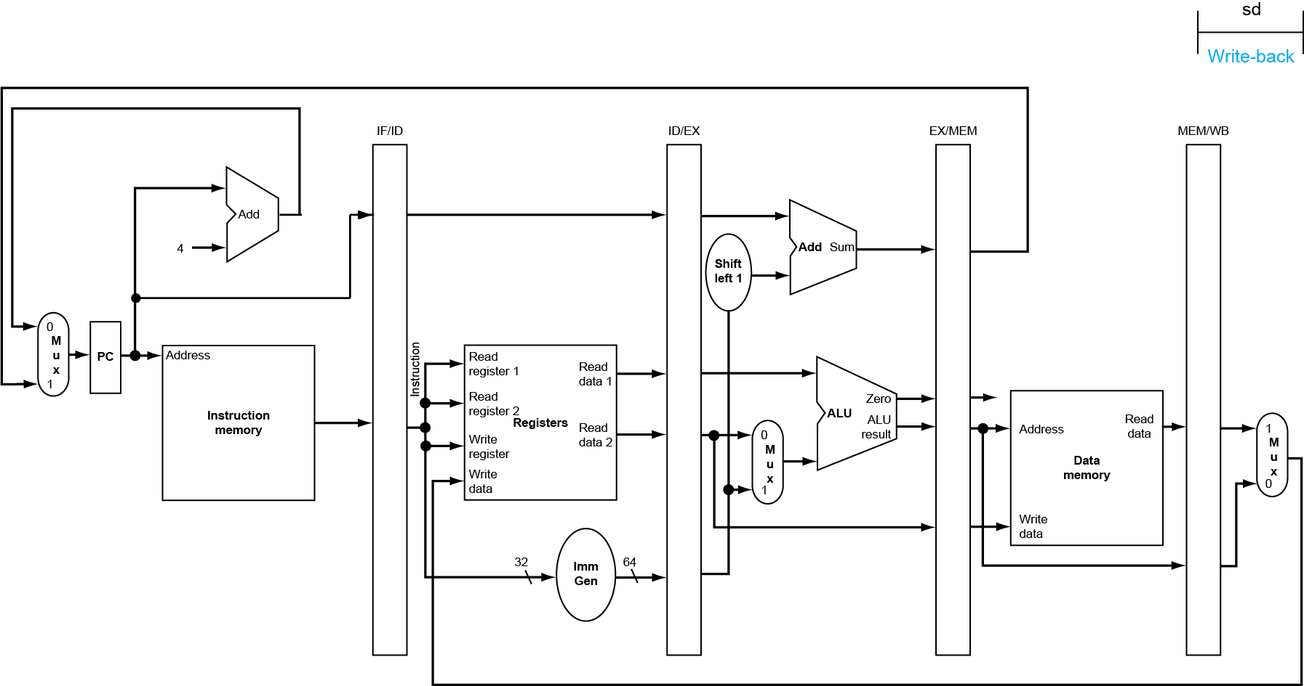
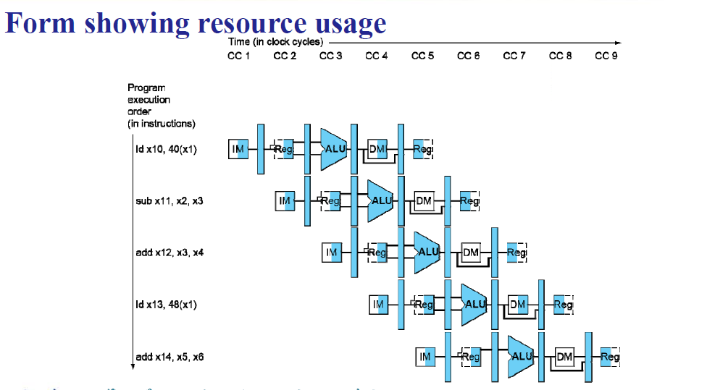
多周期视图
“Single-clock-cycle” pipeline diagram
Shows pipeline usage in a single cycle
Highlight resources used
“multi-clock-cycle” diagram
Graph of operation over time
WB for Store
指令要经过流水线的每一个阶段，即使它在这个阶段什么都不做

Slide 11
Hazard 冒险

Slide 12
Hazards
Stall能解决所有冒险，但是nop不能
Structure hazards结构
多条指令访问同一个资源比如，Load/store requires data access
解决：stall 或者多用几个设备l
Data hazard 数据
Double bump 先写后读
Forwarding
Compiler scheduling 编译器优化
Stall
Control hazard
主要是由一些跳转指令引起的
stall
prediction
Predict-untaken: treat every branch as not taken
Predict-taken: treat every branch as taken

Slide 13
Structural Hazard
Time (clock cycles)
Reading data from memory or writeing data to memory
ld
Mem
Reg
ALU
Mem
Reg
I
n
s
t
r.
O
r
d
e
r
Inst 1
Mem
Reg
ALU
Mem
Reg
解决的方法是把MEM拆解成IM和DM两个寄存器
Inst 2
Mem
Reg
ALU
Mem
Reg
Inst 3
Mem
Reg
ALU
Mem
Reg
Inst 4
Reading instruction from memory
Mem
Reg
ALU
Mem
Reg

Slide 14
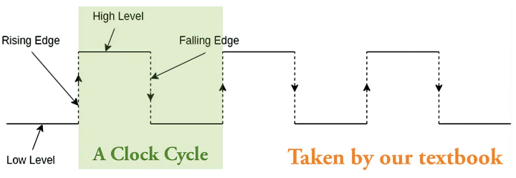
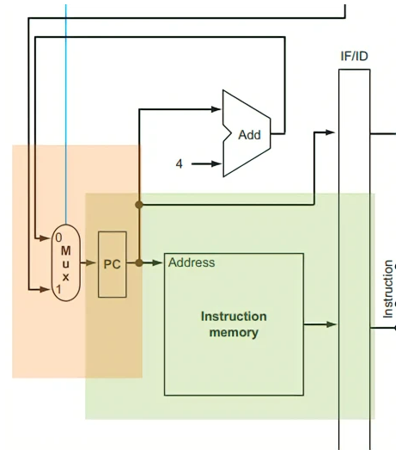
I
n
s
t
r.
O
r
d
e
r
add x1,
IM
Reg
ALU
DM
Reg
Inst 1
IM
Reg
ALU
DM
Reg
Inst 2
IM
Reg
ALU
DM
Reg
一个时钟周期
add x2,x1,
IM
Reg
ALU
DM
Reg
double bound
Reg上升沿写，下降沿读
如果 PC 在上升沿写入，也就是在上升沿更新到下一条指令的位置，那么在下降沿要将当前指令写入 IF/ID 的时候，从 inst mem 中读出的指令已经是下一条而不是当前指令了！所以我们必须让 PC 在下降沿写入，这样才能读取到正确的指令
Reg files 的写入均发生在上半周期，也就是上升沿；而 Pipeline registers 和 PC 的写入均发生在下半周期，也就是下降沿

Slide 15
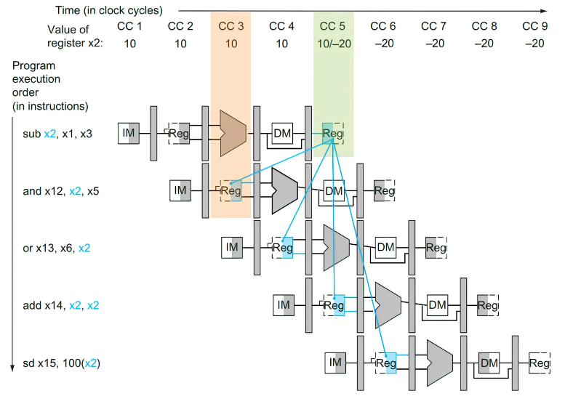
IM 就是 inst mem，对应 IF stage； Reg 就是 reg file，对应 ID stage；长得像 ALU 的就是 ALU，对应 EX stage； DM 就是 data mem，对应 MEM stage；最后面的 Reg 也是 reg file，对应 WB stage。每个 stage 占用一个时钟周期。
图中深色（灰色、蓝色）的部分就是对应指令会使用到的组件，其中 mem 和 reg file 用左半边为深色表示 写入，右半边为深色表示 读取

Slide 16
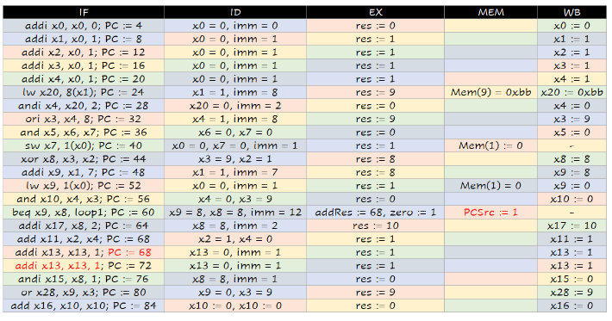
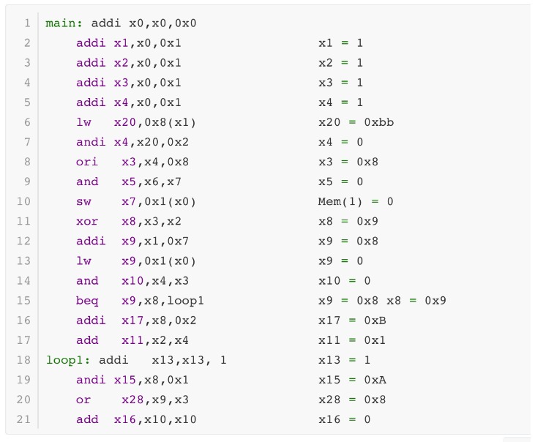
模拟指令运行
规律：
1. 某条指令 (例如 #10 ) WB 阶段做的寄存器更改，其之后第三条指令 ( #13 ) 的 ID 阶段才能读出新的值；
2. 某条指令 (例如 #10 ) MEM 阶段产生 PCSrc = 1 的信号，此时其之后第三条指令 ( #13 ) 正在运行 IF 阶段，它运行结束后才会将 PC 置为实际上要跳转的指令，因此如果要跳转的话， #11 , #12 , #13 这三条语句是额外运行的；如果不用跳转就什么事都没有了；
3. 不存在其他影响结果的情况了！

Slide 17
forwarding

Slide 18
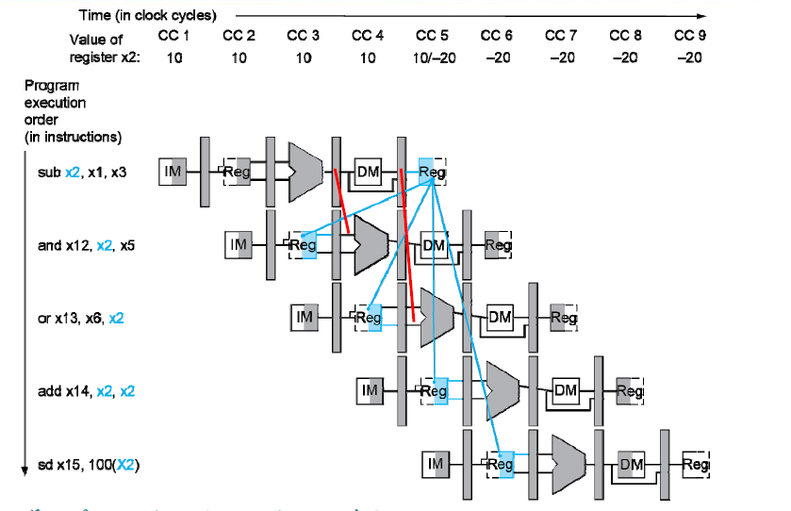

Slide 19
Detecting the Need to Forward
看后指令的rs1，rs2，是否和前一条指令的rd来看是否需要前递
相同并且RegWrite=1
1a. EX/MEM.RegisterRd = ID/EX.RegisterRs1
1b. EX/MEM.RegisterRd = ID/EX.RegisterRs2
2a. MEM/WB.RegisterRd = ID/EX.RegisterRs1
2b. MEM/WB.RegisterRd = ID/EX.RegisterRs2
Fwd from EX/MEM pipeline reg
Fwd from MEM/WB pipeline reg
EX/MEM.RegWrite | MEM/WB.RegWrite ==1

Slide 20
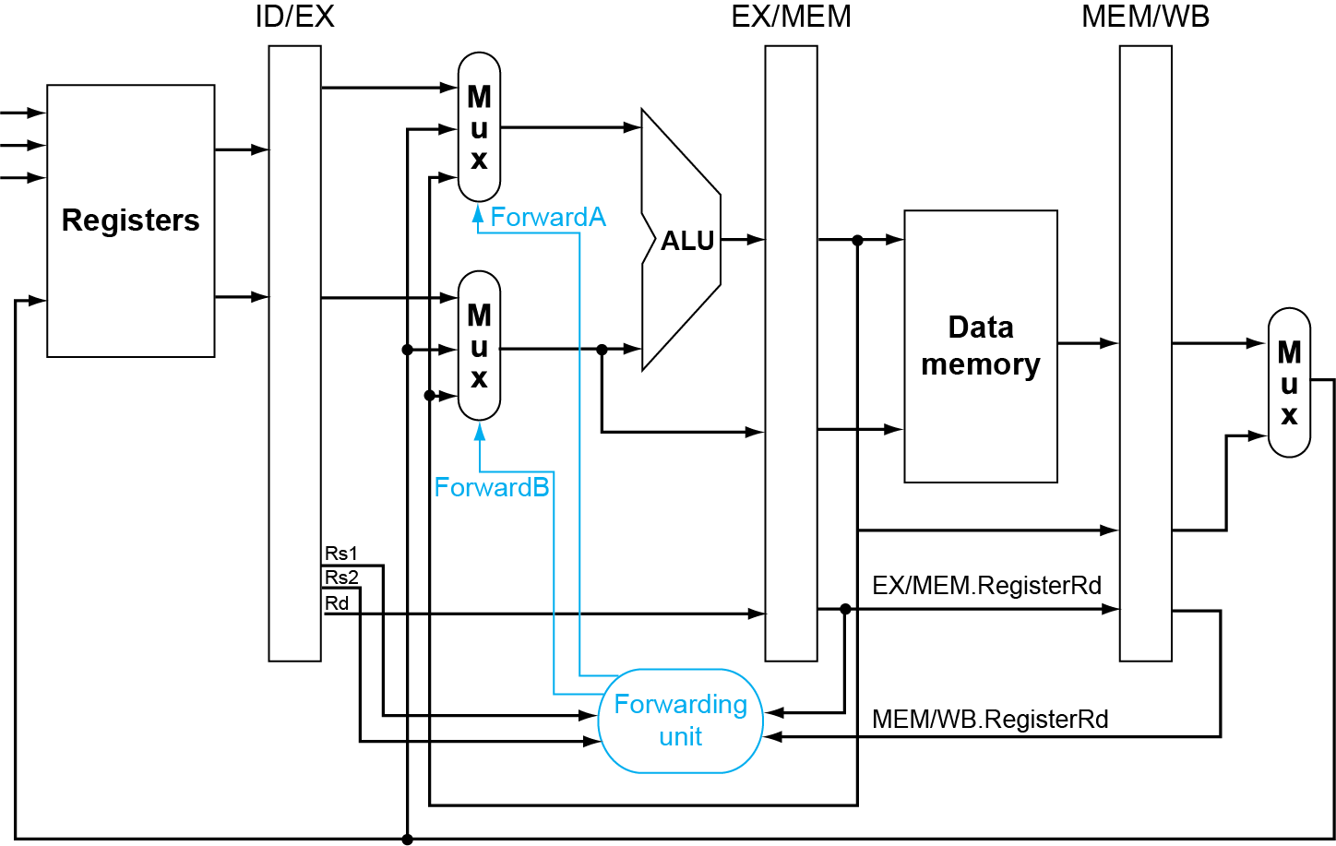
Forwarding Paths

Slide 21
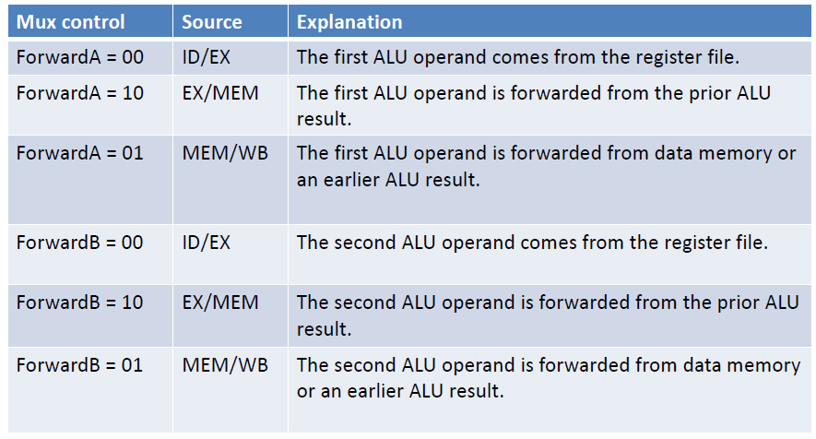
Forwarding Conditions

Slide 22
Double Data Hazard
Consider the sequence:
add x1,x1,x2 add x1,x1,x3 add x1,x1,x4
Both hazards occur
Want to use the most recent
Revise MEM hazard condition
Only fwd if EX hazard condition isn’t true
对于第3条指令：这个时候x1有3个来源

Slide 23
Revised Forwarding Condition
MEM hazard
if (MEM/WB.RegWrite and (MEM/WB.RegisterRd ≠ 0) and not (EX/MEM.RegWrite and (EX/MEM.RegisterRd ≠ 0) and (EX/MEM.RegisterRd = ID/EX.RegisterRs1)) and (MEM/WB.RegisterRd = ID/EX.RegisterRs1)) ForwardA = 01
if (MEM/WB.RegWrite and (MEM/WB.RegisterRd ≠ 0) and not (EX/MEM.RegWrite and (EX/MEM.RegisterRd ≠ 0) and (EX/MEM.RegisterRd = ID/EX.RegisterRs2)) and (MEM/WB.RegisterRd = ID/EX.RegisterRs2)) ForwardB = 01

Slide 24
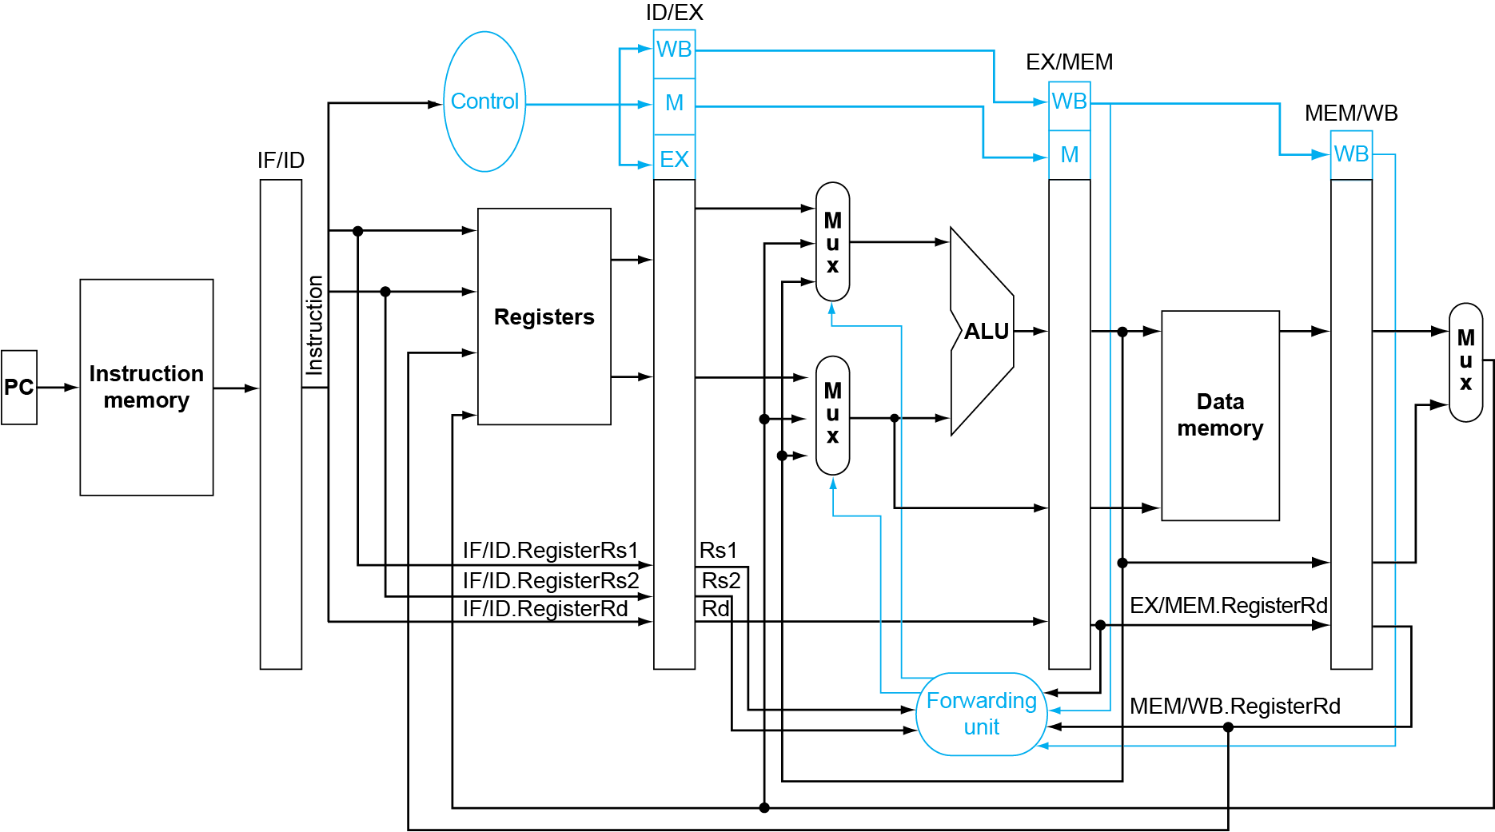
解决二次冲突的forwarding的数据通路

Slide 25
Load :have to stall

Slide 26
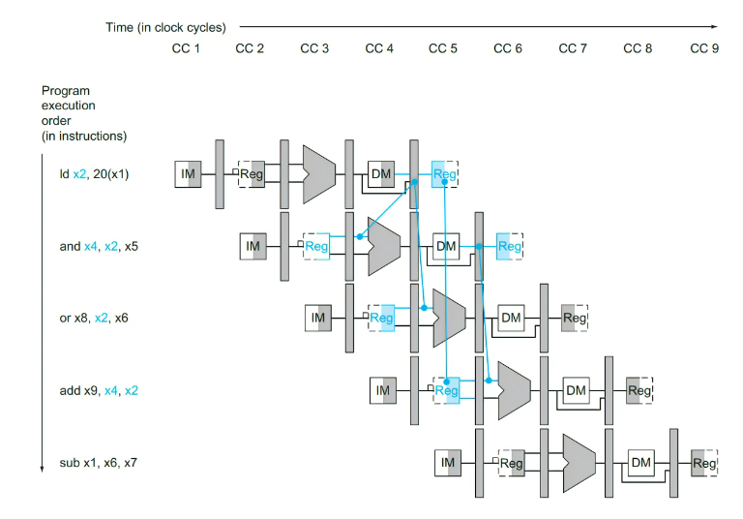
遇到load指令就不得不stall
因为这个值还没有算出来

Slide 27
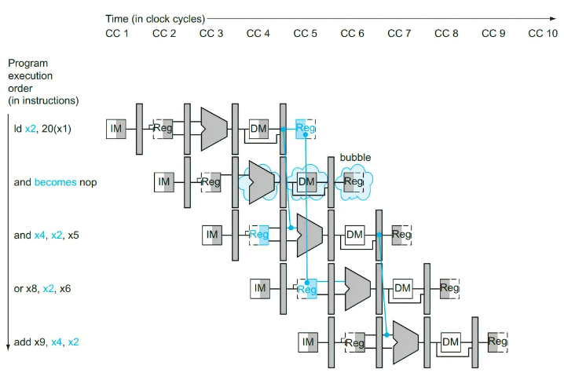
ID/EX.MemRead and ((ID/EX.RegisterRd = IF/ID.RegisterRs1) or (ID/EX.RegisterRd = IF/ID.RegisterRs2))

Slide 28
stall

Slide 29
Stall = control hazard || structural hazard || data hazard
Control hazard:
Instruction in EX or MEM is a Branch or J
Data hazard:
rd of Instruction in EX == rs1 or rs2 of instruction in ID
rd of Instruction in MEM == rs1 or rs2 of instruction in ID

Slide 30
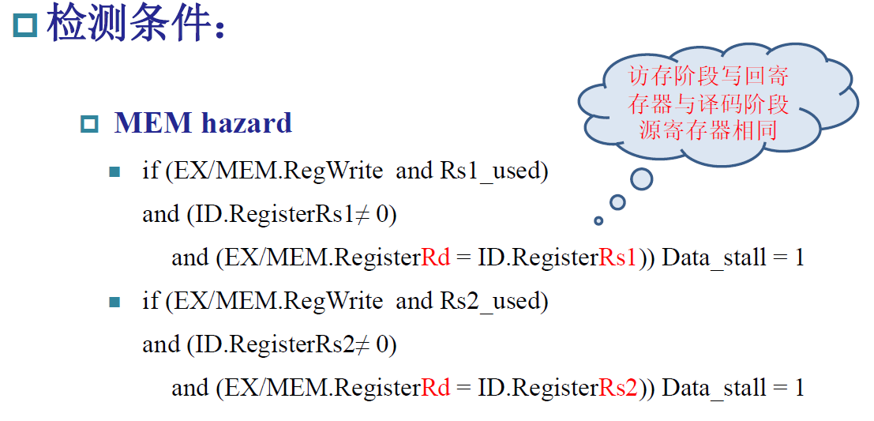
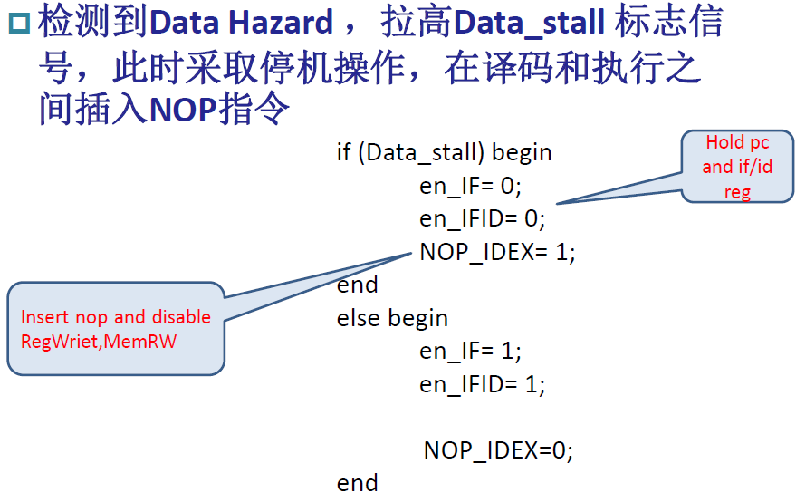
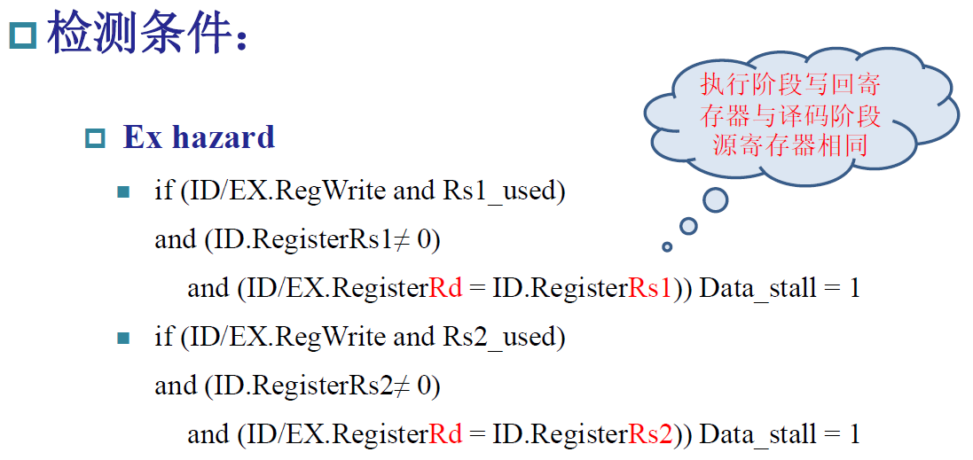

Slide 31
PC IF/ID ID/EX EX/MEM MEM/WB
D.Inst
E.Inst
M.Inst
F.Inst
Bubble
Bubble
Branch
Branch
Wreg
Wreg
rd
rd
Stall control logic
rs1
rs2
stall
插入一个nop
1. 让当前指令不要产生效果 (清空 RegWrite 和 MemWrite )
2. 让后面的语句不要受到影响 (保留 PC 和 IF/ID 一周期不改)

Slide 32
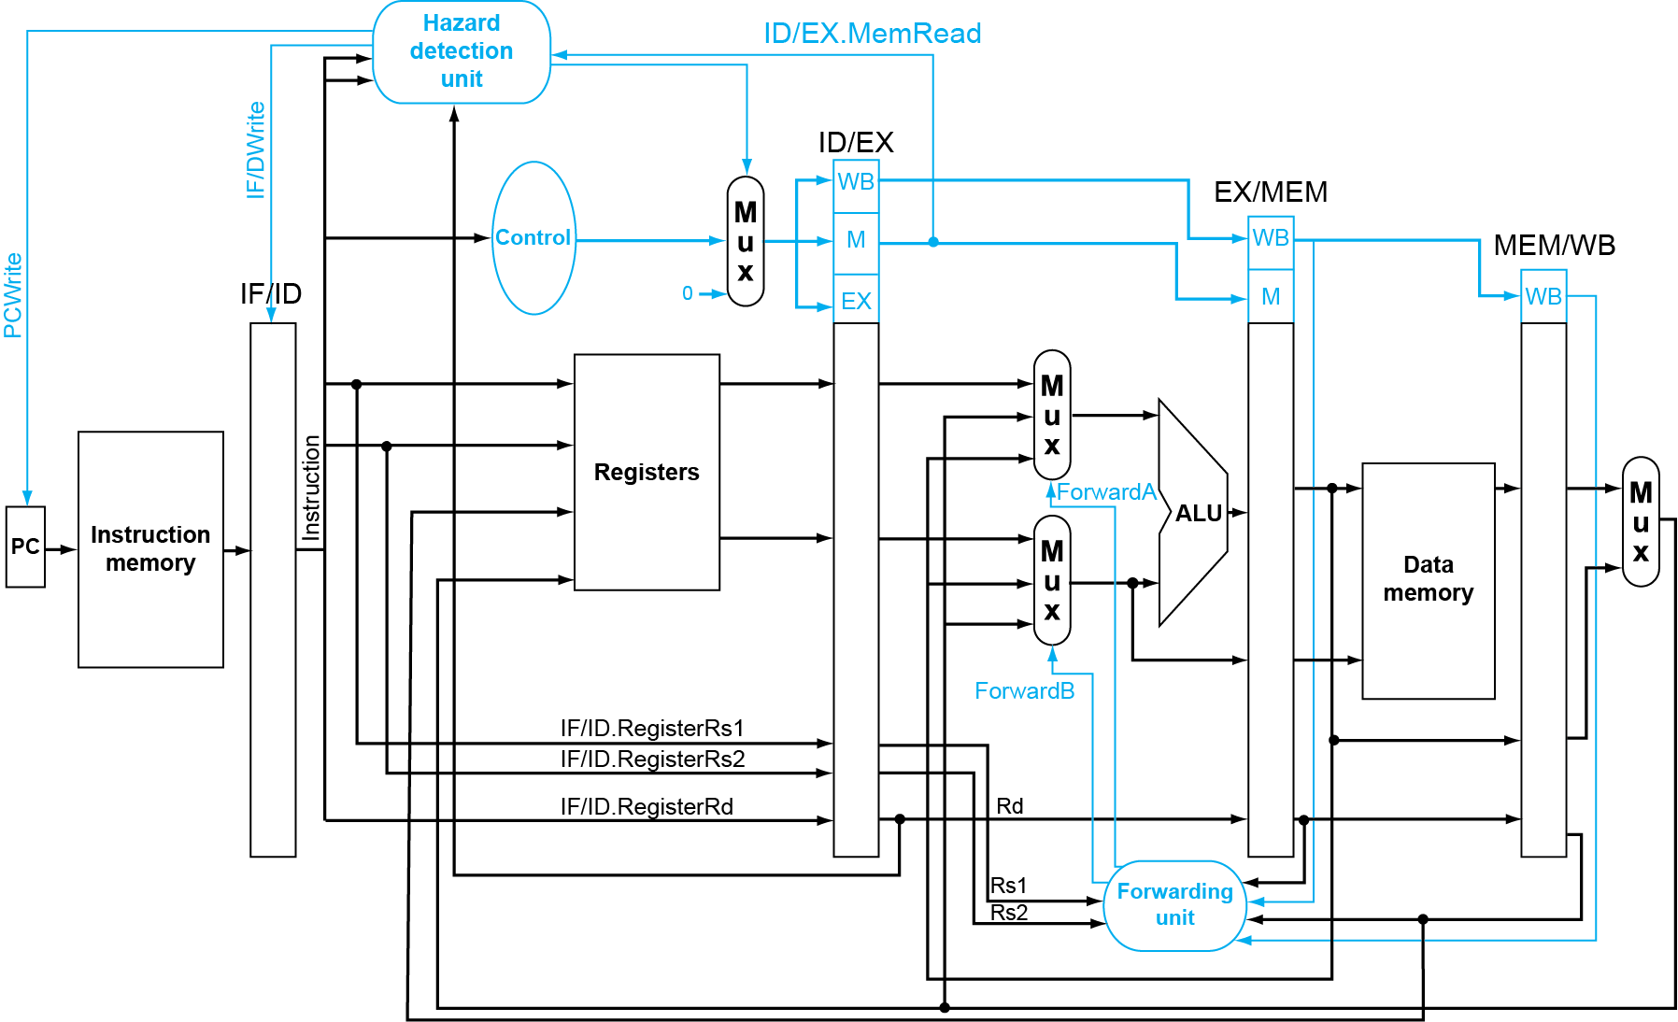
Datapath with Hazard Detection

Slide 33
Control hazard

Slide 34
Stalls greatly hurt the performance
Problem:
With a 30% branch frequency and an ideal CPI of 1, how much the performace is by inserting stalls ?
Answer:
CPI = 1+30%×３＝1.9
this simple solution achieves only about half of the ideal performance.

Slide 35
Flushing the pipeline
Simplest hardware:
Holding or deleting any instruction after branch until the branch destination is know.
Penalty is fixed.
Can not be reduced by software.

Slide 36
Predict –not-taken
Treat every branch as not taken (or as the formal instruction)
When branch is not taken, the fetched instruction just continues to flow on. No stall at all.
If the branch is taken, then restart the fetch at the branch target, which cause 3 stall.(should turn the fetched instruction into a no-op)
Perf = 1+ br% * take%* 3

Slide 37
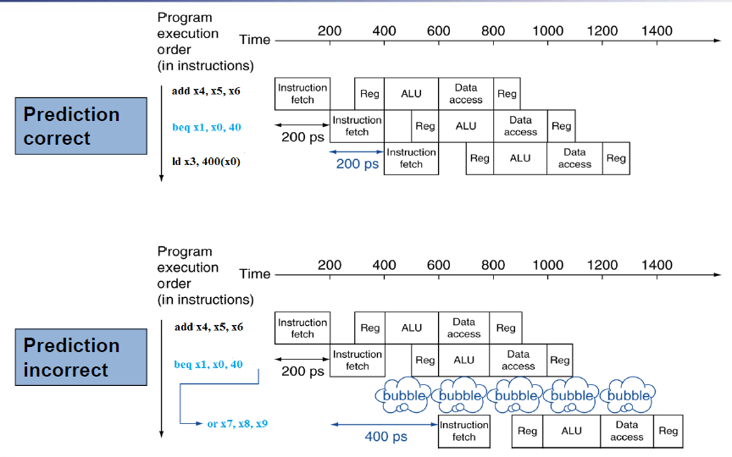

Slide 38
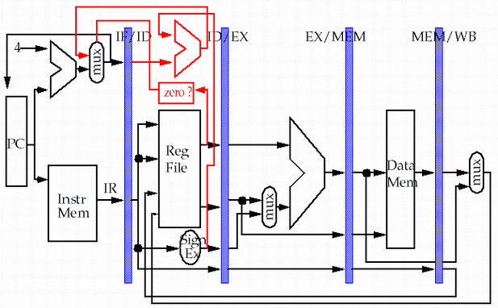
方法3：Branch Computation more Forward
只需要一个stall了
store
load

Slide 39
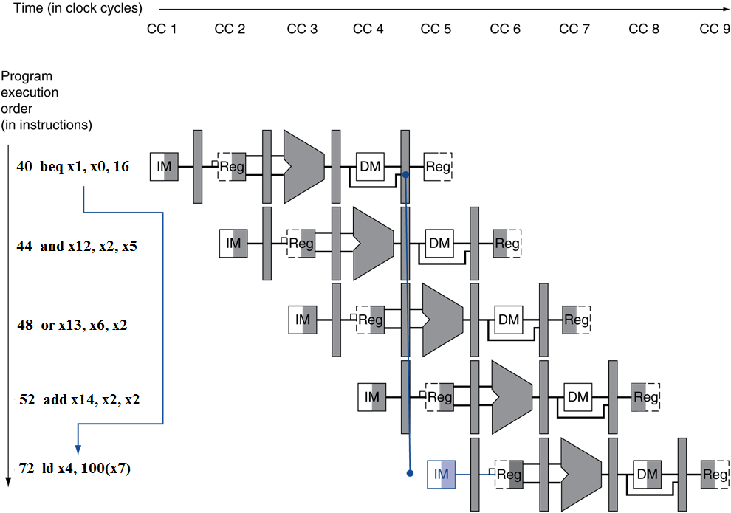
Control Hazards – Branch Instruction
If branch outcome determined in MEM
Flush these instructions
(Set control values to 0)
PC

Slide 40
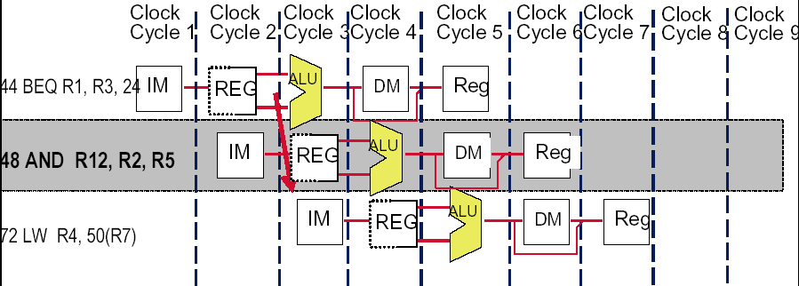
Flushing : need only to insert 1 stall
48 or 72
40 ADD R30,R30,R30 | IF | ID | EX | MEM | WB
44 BEQ R1, 24 |  | IF | ID | EX | MEM | WB
48 AND R12, R2, R5 |  |  | IF | idle | idle | idle | idle
48 or 72 |  |  |  | IF | ID | EX | MEM

Slide 41
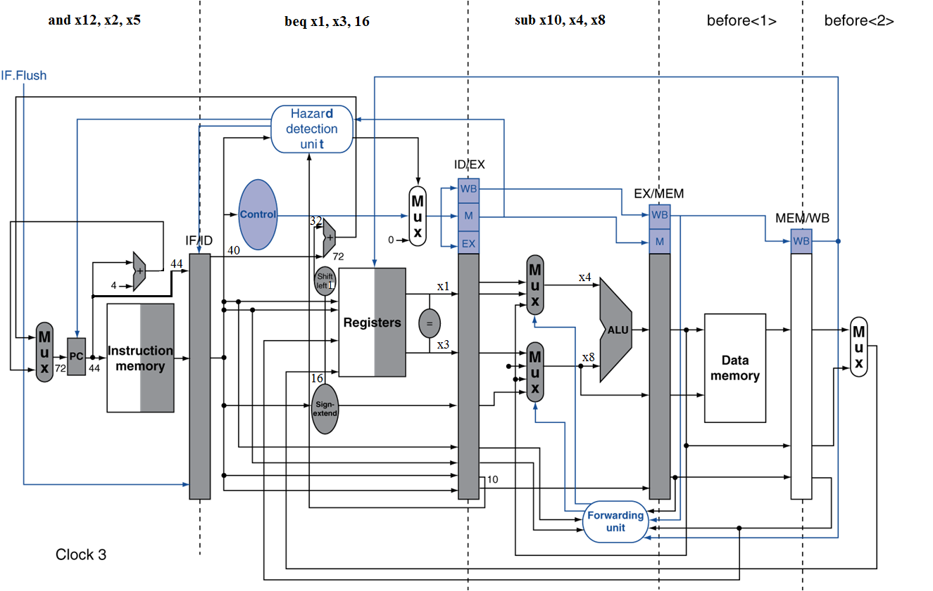
Example: Branch Taken

Slide 42
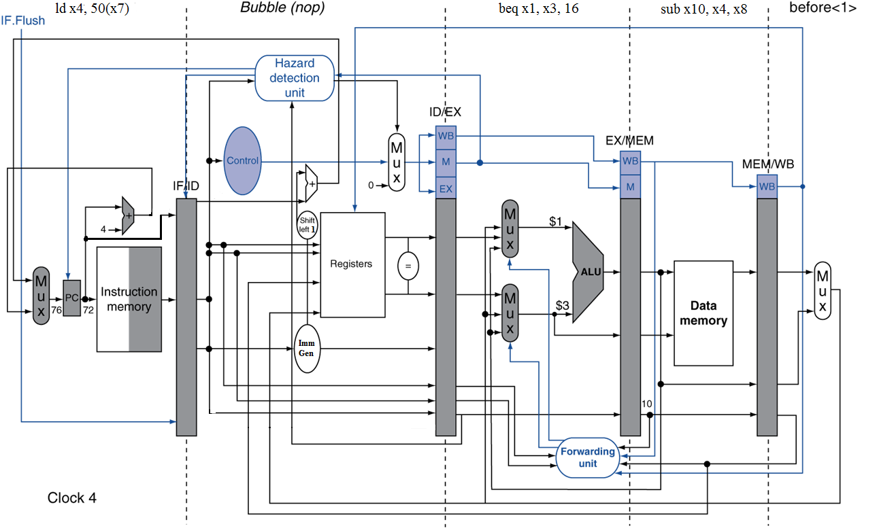
Example: Branch Taken

Slide 43
If a comparison register is a destination of 2nd or 3rd preceding ALU instruction
add x1, x2, x3
IF
ID
EX
MEM
WB
add x4, x5, x6
IF
ID
EX
MEM
WB
…
IF
ID
EX
MEM
WB
beq x1, x4, target
IF
ID
EX
MEM
WB
Can resolve using forwarding

Slide 44
If a comparison register is a destination of preceding ALU instruction or 2nd preceding load instruction
Need 1 stall cycle
ld x1, addr
IF
ID
EX
MEM
WB
add x4, x5, x6
IF
ID
EX
MEM
WB
beq stalled
IF
ID
beq x1, x4, target
ID
EX
MEM
WB

Slide 45
If a comparison register is a destination of immediately preceding load instruction
Need 2 stall cycles
ld x1, addr
IF
ID
EX
MEM
WB
beq stalled
IF
ID
beq stalled
ID
beq x1, x0, target
ID
EX
MEM
WB

Slide 46
More-Realistic Branch Prediction
Static branch prediction
Based on typical branch behavior
Example: loop and if-statement branches
Predict backward branches taken
Predict forward branches not taken
Dynamic branch prediction 动态预测
Hardware measures actual branch behavior
e.g., record recent history of each branch
Assume future behavior will continue the trend
When wrong, stall while re-fetching, and update history
不是固定预测跳或者不跳，而会根据之前的结果来决定

Slide 47
1-bit predictor
Branch History Table: Lower bits of PC address index table of 1-bit values
Says whether or not branch taken last time
No address check (saves HW, but may not be right branch)
0：not taken
1：taken
0/1
Low bits of PC
预测行为
Complement when mispredict

Slide 48
1-Bit Predictor缺点
Inner loop branches mispredicted twice!
outer: … … inner: …
…
beq …, …, inner … beq …, …, outer
Mispredict as taken on last iteration of inner loop
Then mispredict as not taken on first iteration of inner loop next time around

Slide 49
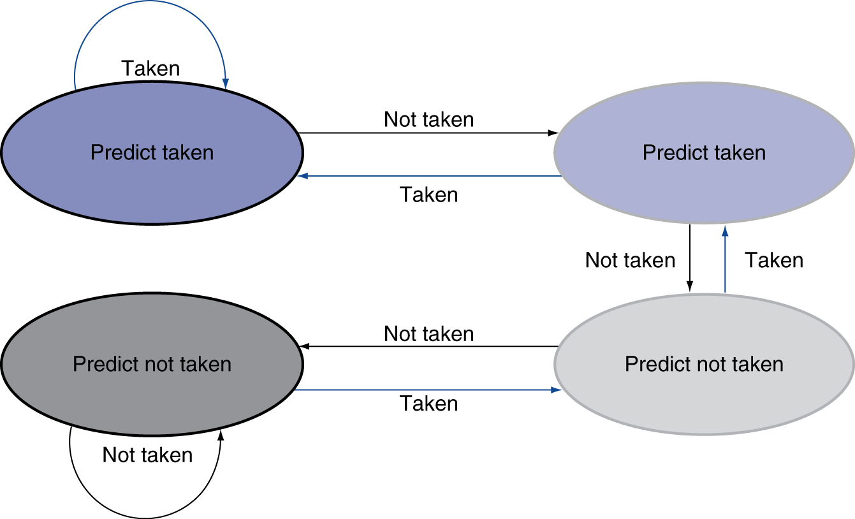
2-Bit Predictor
Only change prediction on two successive mispredictions

Slide 50
An alternative 2-bit predictor
It can be implemented using a 2-bit counter
T
NT
Predict Taken
Surely
Predict Taken
T
T
NT
NT
Predict Not
Taken
Predict Not
Taken surely
T
NT

Slide 51
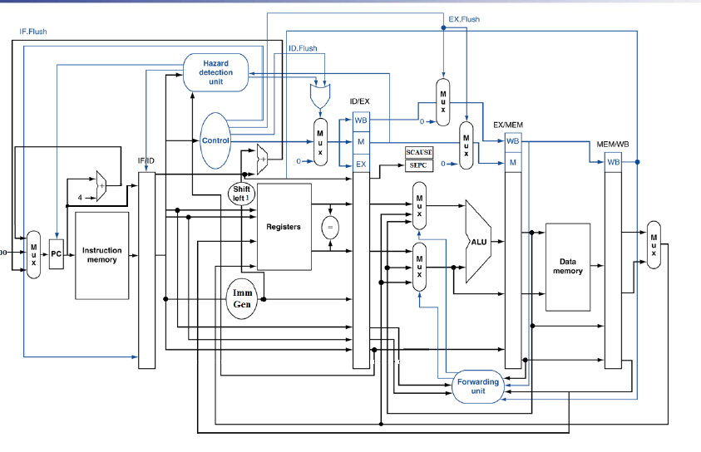

Slide 52
流水线 CPU 性能

Slide 53
Something about control signals
How to know the instruction in EXE/MEM is a Branch?
EXE.branch ==1 or Mem.branch == 1
How to know the instruction in EXE/MEM is a ALU or LW instruction ( has a destination reg.) ?
EXE.Wreg ==1 or Mem.Wreg == 1
How to know the instruction in EXE/MEM is a LW ?
EXE.Wreg==1 and Mem2Reg == 1
Which instruction has no rd?
Sw, Branch
Which instruction has no rs ?
JAL, LUI
Which instruction has rs2 as source register?
ALU r-r, Branch, SW

Slide 54
Assumptions for calculation
The ideal CPI on a pipelined processor is almost always 1. (may less than or greater than )
So
Ignore the overhead of pipelining clock cycle.
Pipe stages are ideal balanced.

Slide 55

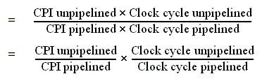
Performance of pipeline with stalls
Notes:
单周期 CPI=1 ,clock =5
流水线 CPI=1, clock =1
流水线，理想的速度为阶段数分之一
但是有了stall之后CPI变大了

Slide 56

Case of single-cycle implementation
CPI unpipelined = 1
Clock cycle unpipelined
pipeline depth
Clock cycle pipelined =

Slide 57
Machine without structural hazards will always have a lower CPI
Example
Data reference constitute 40% of the mix
Ideal CPI ignoring the structural hazard is 1
The processor with the structural hazard has a clock rate that is 1.05 times higher than that of a processor without structural hazard.
Answer
Average instruction time = CPI×Clock cycle time
=(1+0.4 ×1) ×CC_{ideal}/1.05
= 1.3 × Cc_{ideal}
Clearly, the processor without the structural hazard is faster.
Why allow machine with structural hazard ?
节约成本.
减少延时

Slide 58
Example: impact of structural hazard to performance
Example
The function unit time of FP multiplier浮点数乘法器 is 6 clock cycles
FP multiply has a frequency of 14% in a SPECfp benchmark
Will the structural hzard have a large performance impact on the SPECfp benchmark?

Slide 59
Answer to the example
In the best case: FP multiplies are distributed uniformly.
There is one multiply in every 7 clock. 1/14%
Then there will be no structural hazard,then there is no performance penalty at all.
In the worst case: the multiplies are all clustered with no intervening instructions.
Then every multiply instruction have to stall 5 clock cycles to wait for the multiplier be released.
The CPI will increase 70% to 1.7, if the ideal CPI is 1.

Slide 60
performance influence of load stall
Example
Assume 30% of the instructions are loads.
Half the time, instruction following a load instruction depends on the result of the load.
If hazard causes a single cycle delay, how much faster is the ideal pipeline ?
Answer
CPI = 1+30%×50% ×1=1.15
The performance decrease about 15% due to load stall.
好的编译器，在编译的时候会自动调整一些指令的顺序，使得执行被优化

Slide 61
